Slide 1
Rust
Designed for Safety
Carol (Nichols || Goulding)
@carols10cents
Notes:
This is a talk I gave as a guest lecture at a software testing class at Pitt; updated to include a new case study.
What languages are people coming from?
How long have people used Rust?

Slide 2
How does Rust prevent bugs?
What kinds of bugs are still possible?
Case studies: Would Rust have prevented these problems?
Notes:
Our agenda for this evening

Slide 3
How does Rust prevent bugs?

Slide 4
How does Rust prevent bugs?
Immutable by default
Array bounds/integer overflow checks
Ownership
Strongly typed
Warnings
`match` must handle all cases
Not allowed to use a variable before initializing
No nullable pointers
No undefined behavior
Notes:
There are a lot of features that Rust has that have caught bugs that I personally was about to write into my code. Part of why I'm interested in Rust is I'm swinging away from Ruby— tired of getting undefined method on nil!
We're going to concentrate on these first three for tonight - 1st two quickly, more time on ownership.

Slide 5
Immutable by default
let x = 5;
x += 10;

Slide 6
Immutable by default
let x = 5;
x += 10;
^ error: re-assignment of
immutable variable `x`

Slide 7
Immutable by default
let mut x = 5;
x += 10;
Notes:
Explicit about what might change, if mut isn't there, don't have to think about what might change that var
Errors if code tries to change something you thought shouldn’t change.
Encourages a functional programming style,
good for concurrency
if you need mutability for memory usage, speed, or convenience, it's there.

Slide 8
Array Bounds Checking
let buffer = [10, 20, 30];
println!("{}", buffer[100]);

Slide 9
Array Bounds Checking
let buffer = [10, 20, 30];
println!("{}", buffer[100]);
thread '<main>' panicked at
'index out of bounds: the len
is 3 but the index is 100'
Notes:
This is a runtime error, since your array length and index could be dependent on user input and therefore couldn't be checked at compile time.
Prevents buffer over/under reads/writes
We'll see how this can prevent bugs in the case study section.

Slide 10
Integer Overflow Checking
let x = 5u8;
let y = 255u8;
println!("x + y is: {}", x + y);
Notes:
u8 is an unsigned 8-bit number
255 is the max value that a u8 can hold

Slide 11
Integer Overflow Checking
let x = 5u8;
let y = 255u8;
println!("x + y is: {}", x + y);
thread '<main>' panicked at 'arithmetic operation overflowed', src/main.rs:4
Notes:
Also a runtime error.
It's assumed that the + sign will never overflow— can explicitly use wrapping, saturating, overflowing, or checked add if that's what you want

Slide 12
NOTE!
Integer overflow checks are by default:
ON in debug mode
OFF in release mode
Can change this to be on in release mode too
Notes:
When these checks are off, array access is allowed and integers wrap.
We'll see an example of changing this setting later.

Slide 13
Ownership
Notes:
Ownership is the most different concept in Rust, and one of the most important for ensuring safety as well as eliminating the need for garbage collection or explicit memory management.

Slide 14
Ownership
Memory has one and only one owning scope
That scope is responsible for freeing the memory
Notes:
This is one way of describing the ownership system.
When you allocate memory on the heap (new instances), gotta clean it up

Slide 15
Shared Mutable State
Use after free
Double free
Data Races
Notes:
One of the largest sources of bugs in programming in general. In languages like C where you have to manually manage your memory, dealing with shared mutable state can manifest itself in these ways

Slide 16
Lexical scoping
fn main() {
let x = Thing::new();
if x.floopy() {
let y = OtherThing::new(x.florp());
println!(“y is {}”, y);
}
// y is no longer valid here, x still is
}
Notes:
x is in scope from where it's declared to the end of main, y is in scope until the end of the if block.
When x and y go out of scope, Rust automatically frees the memory.
What about calling functions with arguments

Slide 17
Move by default

Slide 18
fn main() {
let x = Thing::new();
whatevs(x);
println!(“x is {}”, x);
}
fn whatevs(t: Thing) {
println!(“I just want to print {}”, t);
}

Slide 19
fn main() {
let x = Thing::new();
whatevs(x);
println!(“x is {}”, x);
}
fn whatevs(t: Thing) {
println!(“I just want to print {}”, t);
}
^ error: use of moved
value: `x`
Notes:
This is annoying and unexpected when people pick up Rust.

Slide 20
Borrowing

Slide 21
fn main() {
let x = Thing::new();
whatevs(&x);
println!(“x is {}”, x); // cool.
}
fn whatevs(t: &Thing) {
println!(“I just want to print {}”, t);
}
Notes:
Difference: ampersand at caller and callee indicates borrow
whatevs returns thing, does not clean it up
main is still the owner and does clean up

Slide 22
fn whatevs(t: &Thing) {
t.price += 50;
}
Notes:
Borrows are immutable by default too. If instead of printing, we want to change thing

Slide 23
fn whatevs(t: &Thing) {
t.price += 50;
}
^ error: cannot assign to
immutable field `t.price`

Slide 24
fn whatevs(t: &mut Thing) {
t.price += 50;
}
Notes:
so we can tell by looking at the signature which functions are going to change what.

Slide 25
fn main() {
let mut x = Thing::new();
whatevs(&mut x);
println!(“x is {}”, x);
}
fn whatevs(t: &mut Thing) {
t.price += 50;
}

Slide 26
Borrowing Rules
Many immutable borrows
Only one mutable borrow (and no immutable borrows)

Slide 27
let mut list = vec![1, 2, 3];
for i in &list {
println!(“i is {}”, i);
list.push(i + 1);
}
Notes:
What is this code doing?

Slide 28
let mut list = vec![1, 2, 3];
for i in &list {
println!(“i is {}”, i);
list.push(i + 1);
}
^ error: cannot borrow `list`
as mutable because it is also
borrowed as immutable

Slide 29
These rules apply when using multiple threads too, and make concurrency safe.
(example left as an exercise for the reader)

Slide 30
BUT WAIT! THERE’S MORE!

Slide 31
At COMPILE time!*
*except for array bounds/integer overflow checks
Notes:
Why is this important?
what affects the cost of fixing a bug
what if these checks happened at runtime instead

Slide 32
What bugs are still possible?
Notes:
Is Rust a silver bullet?

Slide 33
unsafe
Notes:
i kinda lied

Slide 34
unsafe keyword lets you…
Dereference a raw pointer
Read or write a mutable static variable
Call an unsafe function
Notes:
Lets you opt out of the compiler’s checks. A way to say “I, the human, have checked this code and found it to uphold the restrictions of safety, so you, the compiler, should let me run whatever is in here”

Slide 35
Rust does not prevent…
Deadlocks
Non-data race conditions
Leaking memory
Failing to call destructors
Crashing the program
And???????
Notes:
What’s a big kind of bug that is still possible in Rust?
Hint: Would you still need to test Rust code?

Slide 36
Logic errors
Notes:
A compiler is never going to be able to check that you’re doing the thing that you want to be doing.
You still need tests, you still need fuzzing

Slide 37
Case Studies

Slide 38


Slide 39
Heartbleed
April 2014

Slide 40
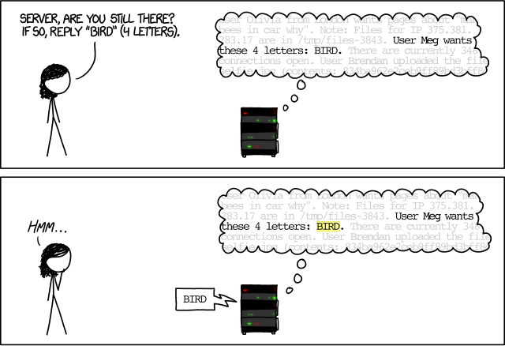

Slide 41
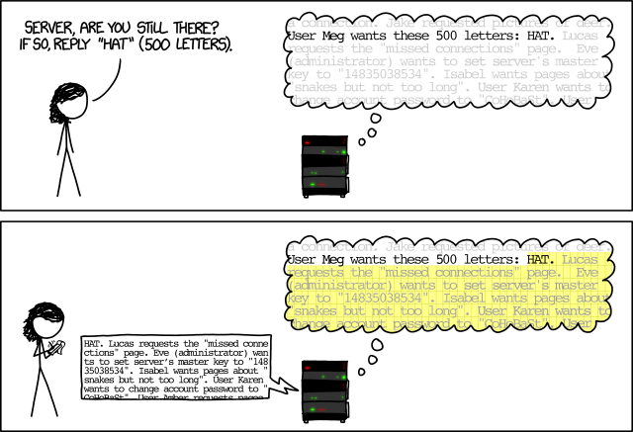

Slide 42
Root causes
Buffer overread
Did not validate user input
Reusing a buffer
Wrote their own memory allocator
Notes:
Not idiomatic C

Slide 43
Rust would help prevent this because…
No out of bound memory reads
Less convenient to share memory

Slide 44
Would Rust have prevented Heartbleed?

Slide 45
Would Rust have prevented Heartbleed?
Maybe.
Notes:
You can write crappy code in any language.

Slide 46
Would Rust have prevented Heartbleed?
Bad Rust < Bad C?
Notes:
Does Rust make it less likely that you’ll write bad code?

Slide 47
Apple `goto fail`
Feb 2014
Notes:
Verifying a signature of a handshake for a secure connection

Slide 48
if ((err = ReadyHash(&SSLHashSHA1, &hashCtx)) != 0)
goto fail;
if ((err = SSLHashSHA1.update(&hashCtx, &clientRandom)) != 0)
goto fail;
if ((err = SSLHashSHA1.update(&hashCtx, &serverRandom)) != 0)
goto fail;
if ((err = SSLHashSHA1.update(&hashCtx, &signedParams)) != 0)
goto fail;
goto fail;
if ((err = SSLHashSHA1.final(&hashCtx, &hashOut)) != 0)
goto fail;
Notes:
If something isn’t right, we need to set `err` and THEN goto fail.
Skipping some of these checks means invalid things might get through WITHOUT getting the value in `err` that they should have, and will look like success.
bad alignment
no curly braces
`goto` makes it hard to follow code
dead code

Slide 49
Rust would help prevent this because…
Required braces around `if` bodies
Dead code warnings on by default
No `goto` statement

Slide 50
fn verify(certificate: &mut Certificate) {
if certificate.valid_until() > Date::today() {
certificate.valid = false;
return;
}
return;
if certificate.ready_hash(&SSL_HASH_SHA) {
certificate.valid = false;
return;
}
}
Notes:
This is my best attempt at reproducing goto fail in Rust; kinda cheating with bad indenting here

Slide 51
fn verify(certificate: &mut Certificate) {
if certificate.valid_until() > Date::today() {
certificate.valid = false;
return;
}
return;
if certificate.ready_hash(&SSL_HASH_SHA) {
^ warning: unreachable statement
certificate.valid = false;
return;
}
}
Notes:
Rust's warnings are generally helpful, I've been keeping them turned on and I resolve warnings as I go to be able to see new ones as I introduce them to help me catch bugs.

Slide 52
Would Rust have prevented `goto fail`?

Slide 53
Would Rust have prevented `goto fail`?
Probably.

Slide 54
libstagefright

Slide 55
libstagefright
C++ library to parse of media metadata
From Android, also used in Firefox
Arbitrary files from possibly-bad actors
On Android, possibly parsed without any user action
Notes:
- mention bug where firefox team was considering which media parser to use

Slide 56
uint8_t *buffer = new (std::nothrow)
uint8_t[size + chunk_size];
^ from the mp4
metadata
Notes:
Allocate a buffer that is size + chunk_size big.
Later code assumes that the buffer is at least size big.
If size + chunk_size overflows, and thus wraps around, the buffer will be less than size and violate a variety of assumptions

Slide 57
+ if (SIZE_MAX - chunk_size <= size) {
+ return ERROR_MALFORMED;
+ }
uint8_t *buffer = new (std::nothrow)
uint8_t[size + chunk_size];
Notes:
Fix #1: check for this overflow condition and disallow it
But there's a problem. If you were reviewing this patch, with the threat of a security vulnerability being out there, would you see it?

Slide 58
size_t (32)
uint64_t
size_t (32)
if (SIZE_MAX - chunk_size <= size) {
return ERROR_MALFORMED;
}
uint8_t *buffer = new (std::nothrow)
uint8_t[size + chunk_size];
Notes:
C lets you do arithmetic operations on integers of different types :(

Slide 59
let SIZE_MAX = u32::MAX;
let size = 10u32;
let chunk_size = 2u64.pow(33);
if (SIZE_MAX - chunk_size) <= size {
Notes:
If we try to translate this directly to Rust, even if there's lots of code in between the declarations and the use of these variables,

Slide 60
let SIZE_MAX = u32::MAX;
let size = 10u32;
let chunk_size = 2u64.pow(33);
if (SIZE_MAX - chunk_size) <= size {
^ error: mismatched types
expected type `u32`
found type `u64`
Notes:
when we try to compile and use this code, Rust will complain.

Slide 61
let SIZE_MAX = u32::MAX;
let size = 10u32;
let chunk_size = 2u64.pow(33);
if (SIZE_MAX - chunk_size as u32) <= size {
Notes:
casting as u32 is.. kinda weird, but the logic works out
casting SIZE_MAX and size as u64 also works— gotta have overflow checks on.

Slide 62
Root causes
Untrusted input*
Integer overflow
No static typing
Code review tools lack context
Notes:
untrusted input comes with this territory

Slide 63
Would Rust have prevented the `libstagefright` issue?

Slide 64
Would Rust have prevented the `libstagefright` issue?
Probably.

Slide 65
Would Rust have prevented the `libstagefright` issue?
Mozilla's betting on it.
mozilla/mp4parse-rust
Notes:
Has integer overflow checks turned on in release mode
They've done fuzzing
I tried to find the part in their code like the bug, but it's not a translation, it's a reimplementation in idiomatic rust so looks pretty different. Or I don't understand the code well enough to spot it.

Slide 66
the point?

Slide 67
“Let them have knives!”

Slide 68
"The best way to prevent these kinds of attacks is either to use a higher level language, which manages memory for you (albeit with less performance), or to be very, very, very, very careful when coding. More careful than the entirety of the Android security team, for sure."
xda-developers.com/a-demonstration-of-stagefright-like-mistakes/

Slide 69

Computers are good at tedium.
⚠️Beep, boop. You forgot a
semicolon in 23,982 places

Slide 70
Rust has the computer
handle more tedium,
so you can concentrate
on your real problem.
Notes:
Rust is not the only tool to do this - we NEED many different ways to make programming correctly easier
I want to keep seeing innovation like this
We don’t have to keep creating the same bugs over and over

Slide 71
Questions?

Slide 72
is.gd/rust_safety

Slide 73
Rust Belt Rust Conference
Thurs Oct 27-Fri Oct 28, 2016
rust-belt-rust.com
@rustbeltrust
ON SALE NOW!!!

Slide 74

Rust Consulting
integer32.com

